Slide 1
Team Name: Git Me Outta Here
Team Leader Name: Aryan Hardik Dani
Project Title & Theme
DoseFlow - AI-Powered Medication Guide for Accessibility
Members Details
Himali Bharat Dandavate
College Name - MIT World Peace University

Slide 2
Problem Statement ->
A global accessibility crisis in medication information puts millions at daily risk, particularly older adults, the visually impaired, and those with low literacy. Complex labels and poor packaging design fuel widespread medication errors, leading to diminished health outcomes, hospitalizations, and increased healthcare burdens. Existing accessibility adaptations are insufficient and poorly standardized, critically undermining patient safety and equity.
Proposed Solution ->
DoseFlow -> AI-powered web application designed to help visually impaired, elderly, or low-literacy individuals understand complex medication labels. By allowing users to upload a photo of their medication using their phone, DoseFlow uses OCR to extract text, NLP to identify and simplify key information like drug name, dosage, frequency, instructions, and warnings, and then reads it aloud using text-to-speech explaining the medication in simple terms. The web app is built with accessibility in mind featuring large fonts and high-contrast visuals.

Slide 3
Technological Stack ->
Core Web: HTML5, CSS3, JavaScript (ES6+)
Key Browser APIs: WebRTC (Camera Access), Web Speech API (Text-to-Speech)
Backend & Processing: Python (Flask/Django)
AI Pipeline:
OCR: Tesseract / Cloud Services
NLU: spaCy/NLTK + Transformers (BERT) for NER & Simplification
Advantages -
Maximum Reach: Web-based works on any device, no app install needed.
Uses Browser Features: Leverages built-in camera (WebRTC) & speech (Web Speech API).
Powerful Python AI: Access to flexible libraries for OCR, NLU, and text simplification.
Cost-Effective: Standard web technologies simplify development and reduce costs.
Scalable Design: Start simple, integrate advanced cloud AI or features as needed.

Slide 4
Use Cases
Scan & Simplify: User points their device camera (via browser) at medication packaging; the system extracts, simplifies, and displays crucial information (dosage, frequency, warnings).
Voice Output: User activates Text-to-Speech to have the simplified medication instructions read aloud clearly.
Accessibility Adjustment: User potentially adjusts text size or contrast settings for better visual clarity (handled via CSS/JS).
(Future) Language Translation: User selects a preferred language, and the simplified text is translated accordingly.
Dependencies
User Hardware: Device with a modern web browser, working camera, and internet access. Speakers/headphones for TTS.
Browser APIs: Reliable implementation of WebRTC (getUserMedia) and Web Speech API across target browsers.
User Permissions: Explicit user consent required for camera access.
AI Libraries/Models: Python backend relies on Tesseract/Cloud OCR, spaCy/NLTK, and Transformer models.
Backend Hosting: Reliable hosting environment for the Python application.
Clear Packaging Text: Accuracy depends heavily on the quality and legibility of the text on the physical medication packaging.

Slide 5
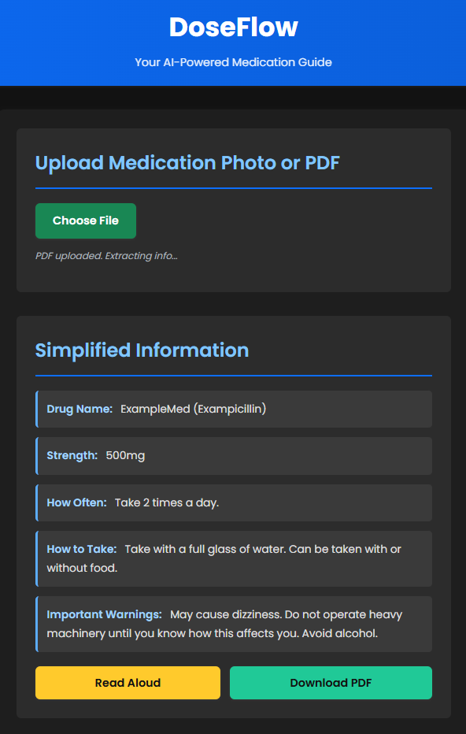
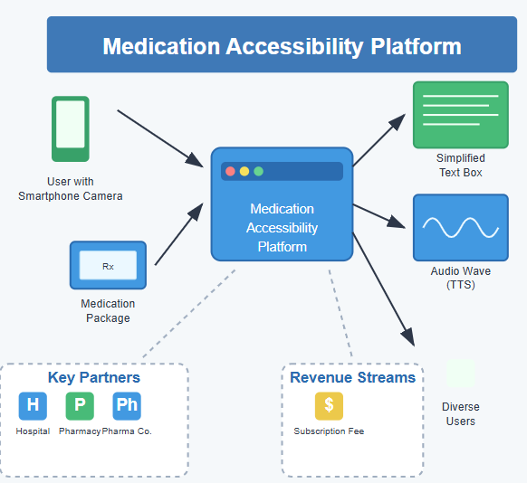
Screenshot of Web Interface
Business Model

